Slide 1


Linux Startup Course
I am root
Florentiu Ilie

Slide 2
Course Content
What is Linux ?
Login/Logout
The shell
Users
SUDO & SU
Moving around (through directories)
Basic Commands
Processes
Mounts
Editing tools: vi

Slide 3

What is Linux ?
Linux is a free computer operating system similar to the UNIX operating system in terms of concepts, features and functionality => UNIX-like operating system
Other characteristics:
open source operating system
is similar to other operating systems you may have used before, such as Windows, OS X
has a graphical interface ( GUI ) – graphical user interface
graphical server = sub-system that displays the graphics on the monitor ( known as X server or just “X” )
Unix developed in the 1970s at Bell Labs
Linux was created in 1991 by Linus Torvalds
known products: Redhat/CentOS, Suse/Opensuse, Ubuntu, Debian
tux:
daemons = services
the shell = command process that allows you to control the computer

Slide 4
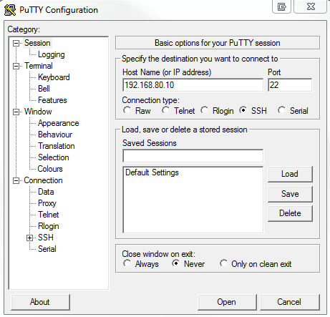
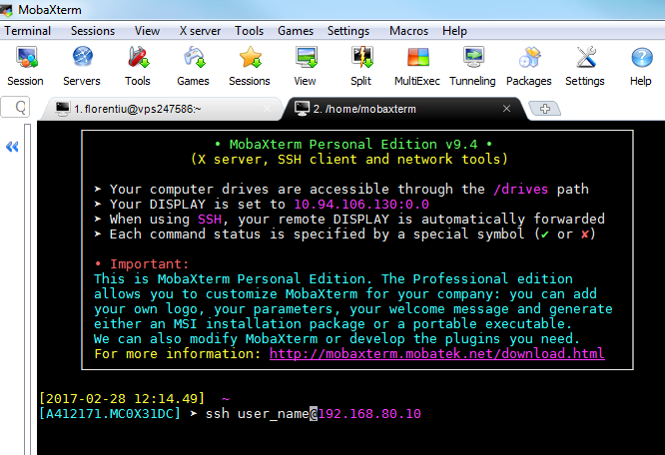
Login/logout
Login can be done directly on the server ( own console ) or remote through adapted programs ( putty, mobaxterm )

Slide 5
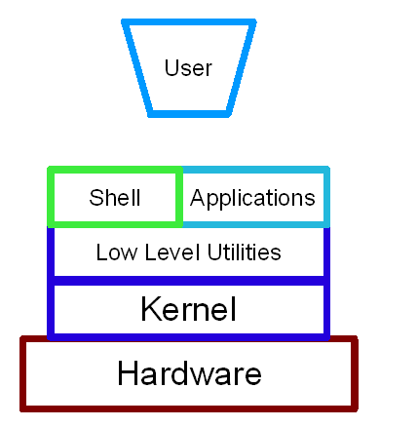
The shell
The shell is the interface between a user and the kernel. User provides instructions (commands) to the shell, which are interpreted and passed to the kernel for processing.
Name of shell | Command name | Description
Bourne shell | sh | The most basic shell available on all UNIX systems
Korn Shell | ksh / pdksh | Based on the Bourne shell with enhancements
C Shell | csh | Similar to the C programming language in syntax
Bash Shell | bash | Bourne Again Shell combines the advantages of the Korn Shell and the C Shell. The default on most Linux distributions.
tcsh | tcsh | Similar to the C Shell

Slide 6
Users
Similar to user Administrator from Windows, in Linux we have root ( uid=0 ) which can do everything on the system.
Important files (where users/groups are stored):
/etc/passwd – details regarding home directory, shell, etc
/etc/shadow – details regarding password encryption, password/account availabilitity
/etc/group – details regarding groups and the users that are part of the groups
Important commands:
useradd/usermod/userdel
passwd
id
chage

Slide 7
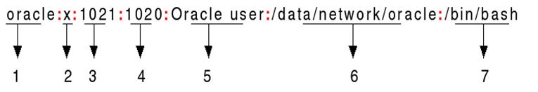
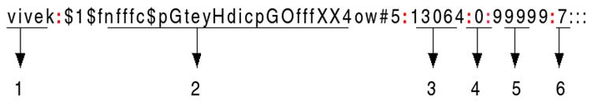
Users
/etc/passwd
/etc/shadow

Slide 8
SUDO & SU
sudo: ( root permissions )
Root is the super user and has the ability to do anything on a system -> sudo is used to have permissions as other users.
reads the content of /etc/sudoers -> gives permissions
syntax: sudo command
su: ( substitute user – login )
command for login with another user while you are still connected.
command makes it possible to change a login session's owner without the owner having to first log out of that session.

Slide 9
Moving around (Through directories)
The main command to “move around” the server is the change directory command: cd
Command | Function
cd | Returns you to your login directory
cd ~ | Also returns you to your login directory
cd / | Takes you to the entire system's root directory
cd /root | Takes you to the home directory of the root, or superuser, account created at installation; you must be the root user to access this directory
cd /home | Takes you to the home directory, where user login directories are usually stored
cd .. | Moves you up one directory
cd ~otheruser | Takes you to otheruser's login directory, if otheruser has granted you permission
cd /dir1/subdirfoo | Regardless of which directory you are in, this absolute path takes you directly to subdirfoo, a subdirectory of dir1
cd ../../dir3/dir2 | This relative path takes you up two directories, then to dir3, then to the dir2 directory

Slide 10
Basic Commands
Command | Description
cat [filename] | Display file’s contents to the standard output device (usually your monitor).
clear | Clear a command line screen/window for a fresh start.
cp [options] source destination | Copy files and directories.
date [options] | Display or set the system date and time.
df [options] | Display used and available disk space.
du [options] | Show how much space each file takes up.
file [options] filename | Determine what type of data is within a file.
find [pathname] [expression] | Search for files matching a provided pattern.
grep [options] pattern [filesname] | Search files or output for a particular pattern.
kill [options] pid | Stop a process. If the process refuses to stop, use kill -9 pid.
less [options] [filename] | View the contents of a file one page at a time.
ln [options] source [destination] | Create a shortcut.
locate filename | Search a copy of your filesystem for the specified filename.
ls [options] | List directory contents.
man [command] | Display the help information for the specified command.
mkdir [options] directory | Create a new directory.
mv [options] source destination | Rename or move file(s) or directories.
pwd | Display the pathname for the current directory.
rm [options] directory | Remove (delete) file(s) and/or directories.
rmdir [options] directory | Delete empty directories.
ssh [options] user@machine | Remotely log in to another Linux machine, over the network. Leave an ssh session by typing exit.
tail [options] [filename] | Display the last n lines of a file (the default is 10).
top | Displays the resources being used on your system. Press q to exit.
touch filename | Create an empty file with the specified name.

Slide 11
processes
A process is created in memory when a program or command is executed.
A unique identification number, known as process identification (PID), is allocated to it.
Process States: running, waiting, sleeping, stopped and zombie.
Stop/Terminate a process: kill -9 PID_name
A process is any program, application or command that runs on the system.
commands:
ps –ef ( equivalent to task manager on windows )
top
top - 14:06:49 up 299 days, 9:34, 309 users, load average: 3.23, 3.70, 4.92
Tasks: 3236 total, 4 running, 3231 sleeping, 0 stopped, 1 zombie
Cpu(s): 18.9%us, 1.0%sy, 0.0%ni, 79.7%id, 0.2%wa, 0.0%hi, 0.2%si, 0.0%st
Mem: 49447872k total, 49185324k used, 262548k free, 541036k buffers
Swap: 2048248k total, 204k used, 2048044k free, 39704080k cached
PID USER PR NI VIRT RES SHR S %CPU %MEM TIME+ COMMAND
8910 s245235 25 0 353m 345m 1012 R 100.0 0.7 50259:50 conssh.sh
15983 a170232 25 0 199m 192m 1012 R 100.0 0.4 20333:51 conssh.sh
22385 a157164 25 0 233m 226m 1012 R 100.0 0.5 16024:12 conssh.sh
12581 a412171 15 0 15152 3532 840 R 2.9 0.0 0:00.69 top

Slide 12
Mounts
Mounting is the act of associating a storage device to a particular location in the directory tree.
Besides filesystems on partitions, floppy disks, and CDs, there are other types of filesystems.
tmpfs – virtual memory filesystem
nfs
cifs
standard linux filesystem types: ext2/3/4, xfs
commands:
mount
df -h

Slide 13
Editing tools: vi
Editing a file in vi is done by issuing the command: vi file-to-edit.txt (ex : vi profile)
The vi editor has three modes, command mode, insert mode and command line mode.
Command mode: letters or sequence of letters interactively command vi. Commands are case sensitive. The ESC key can end a command.
Insert mode: Text is inserted. The ESC key ends insert mode and returns you to command mode. From Command mode you can enter Insert mode with the "i" (insert), "a" (insert after), "A" (insert at end of line), "o" (open new line after current line) or "O" (Open line above current line) commands.
Command line mode: You enter this mode by typing ":" which puts the command line entry at the foot of the screen.

Slide 14

Questions ?

